Slide 1
TRAINITY
PROJECT 4
Hiring Process Analytics

Slide 2
PROJECT DESCRIPTION
This project is about Hiring Process Analytics in multinational company(MNC) using a dataset provided by the company.As a Data Analyst, the task is to extract meaningful insights from the data and to provide the detailed report of the hiring process of the company that can help to improve the company hiring process
.

Slide 3
APPROACH
This project includes checking the missing data, handling techniques for missing data, simplifying the clubbing columns, outliers detection, handling the outliers depending on the situation and data summarization. These methods improve our knowledge of practical using of statistics and Excel to draw meaningful conclusions of company’s hiring process and to make better hiring decisions in the future.

Slide 4
OUTLIER DETECTION
Outliers Detection
3rd Quartile | 74438
1st Quartile | 25460.5
Median | 49625
IQR | 48977.5
Outlier max range | 147904.25
Outlier min range | -48005.75
Outliers
200000
400000
300000

Slide 5
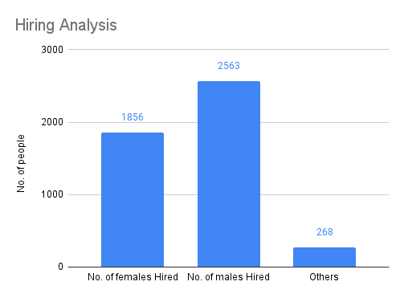
Hiring Analysis
Your Task: Determine the gender distribution of hires. How many males and females have been hired by the company?
Hiring Analysis
No. of females Hired | 1856
No. of males Hired | 2563
Others | 268

Slide 6
B. SALARY ANALYSIS
Your Task: What is the average salary offered by this company? Use Excel functions to calculate this.
As all outlier application-id status are hired, No need to remove outliers. So Including outliers is a better strategy in this situation.
Average Salary
Average salary with Outliers 49983.02902

Slide 7
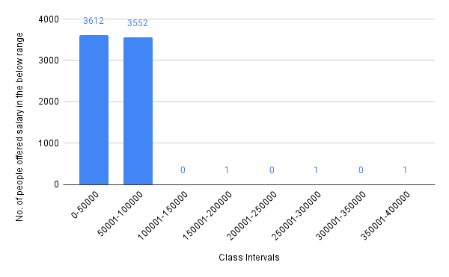
C. Salary Distribution:
Your Task: Create class intervals for the salaries in the company. This will help you understand the salary distribution.
Class Intervals | No. of people offered salary in the below range
0-50000 | 3612
50001-100000 | 3552
100001-150000 | 0
150001-200000 | 1
200001-250000 | 0
250001-300000 | 1
300001-350000 | 0
350001-400000 | 1

Slide 8
D. Departmental Analysis:
Your Task: Use a pie chart, bar graph, or any other suitable visualization to show the proportion of people working in different departments.
Proportion of people working in different departments | No. of people working in each department
Service Department | 205
Operations Department | 2771
Sales Department | 747
Finance Department | 288
Production Department | 380
Purchase Department | 333
Marketing Department | 325
General Management | 172
Human Resources Department | 97

Slide 9
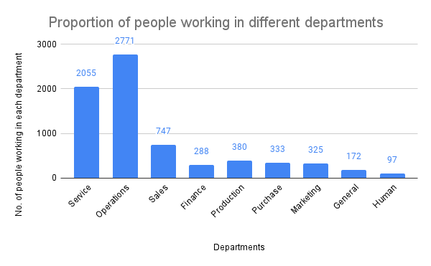

Slide 10
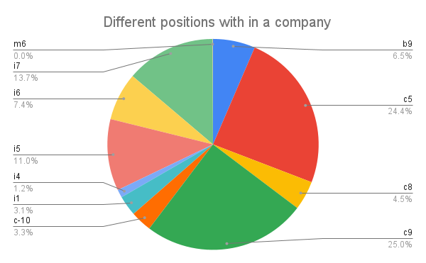
E. Position Tier Analysis:
Your Task: Use a chart or graph to represent the different position tiers within the company. This will help you understand the distribution of positions across different tiers.
Different positions within a company | No. of people in each position
b9 | 463
c5 | 1747
c8 | 320
c9 | 1792
c-10 | 233
i1 | 222
i4 | 88
i5 | 787
i6 | 527
i7 | 982
m6 | 3
n6 | 1
n9 | 1
n10 | 1

Slide 11
TECH-STACK USED :
I used Google Sheets to analyse and visualize the data.
INSIGHTS
I gained knowledge of using data statistics and data visualization in Excel to extract meaningful conclusions of dataset. I came to know that the using of charts depending on the situation of data and charts helps to convey the insights of data more efficiently and quickly.

Slide 12
RESULT
This project was a new experience to me.
Learning new things by these projects.

